Slide 1
Power PREP
FRC3941 Fall Mini Challenge

Slide 2
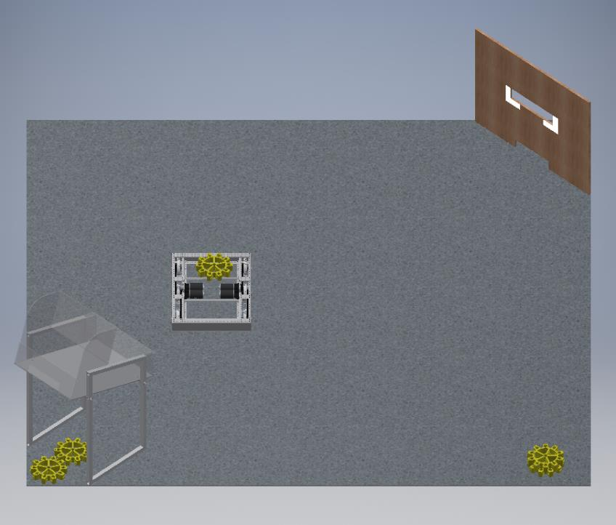
Your Challenge
You must design a ROBOT to deposit COINS in SLOTS
COINS may be found on the floor or be fed through a PLAYER STATION
SLOTS are worth different POINT values
The CHALLENGE will be composed of a 15 second AUTONOMOUS PERIOD and a 135 second TELEOPERATED PERIOD
ROBOTS may PRELOAD one COIN before the match

Slide 3
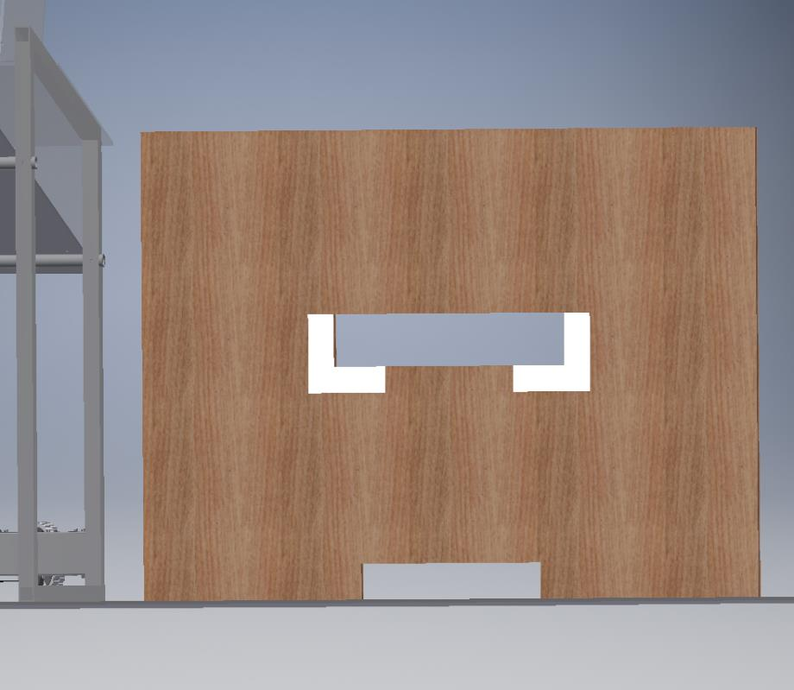
Scoring POINTS
The HIGH SLOT is worth 25 POINTS for each COIN deposited
The LOW SLOT is worth 5 POINTS for each COIN deposited
During AUTONOMOUS, POINT values are tripled
RETROREFLECTIVE TAPE has been applied to the HIGH SLOT to assist ROBOTS in scoring POINTS
HIGH SLOT
LOW SLOT

Slide 4
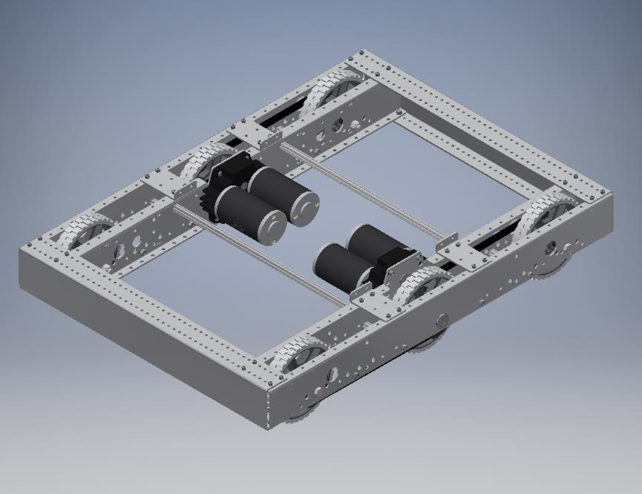
ROBOT Design
You have approximately a dozen Tuesdays in the pre-season left
It is suggested you keep robot designs fairly simple or you may not complete!
Start with a KITBOT, and add MANIPULATORS as desired
ROBOTS must comply with all 2017 ROBOT RULES

Slide 5
Any Questions?
Bonus Incentive:
For every POINT you score in the final round, your mentors will donate $1 to the general TEAM FUND

